Slide 1

“Finance Hero”
Team Silverboy
Bryan Tan | Claudia Chua | Darren Tan | Lee Yuan Kang

Slide 2
Problem Statement
Given the vast amount of information available, how can we help young people who are starting out in investing to learn and make smart investment choices?
Importance of Financial Literacy and Investment Decision-making
Those who have low financial literacy are significantly less likely to invest in stocks Van Rooij et al’s (2011)
20-Year-Old Robinhood Customer Dies By Suicide After Seeing A $730,000 Negative Balance
According to the 2008 wave of the National Longitudinal Survey of Youth, only 27 percent of youth knew what inflation was and could do simple interest rate calculations
Notes:
https://youth.gov/youth-topics/financial-capability-literacy/facts
https://www.forbes.com/sites/sergeiklebnikov/2020/06/17/20-year-old-robinhood-customer-dies-by-suicide-after-seeing-a-730000-negative-balance/#484c89ef1638
https://www.econstor.eu/bitstream/10419/25528/1/559752334.PDF

Slide 3


Proposed Solution
A Web Application that aims to educate young or beginner investors on practical investment knowledge which aids in making sound investment decisions

Slide 4




Solution Details
Profiling
Recommended Portfolio
Bite-size Information
Real-time Annotation
Detailed elaboration on investment products e.g. what is stocks
Indicate key information such as risk appetite, capital & age
Concise and easily digestable investment guides
Train users to interpret complex financial information

Slide 5
Unique Selling Point
Focused
Practical
Users will be guided on what information to look out for in news or statements
Allows user to acquire skills that helps them in future investment

Slide 6






Technology Used

Slide 7
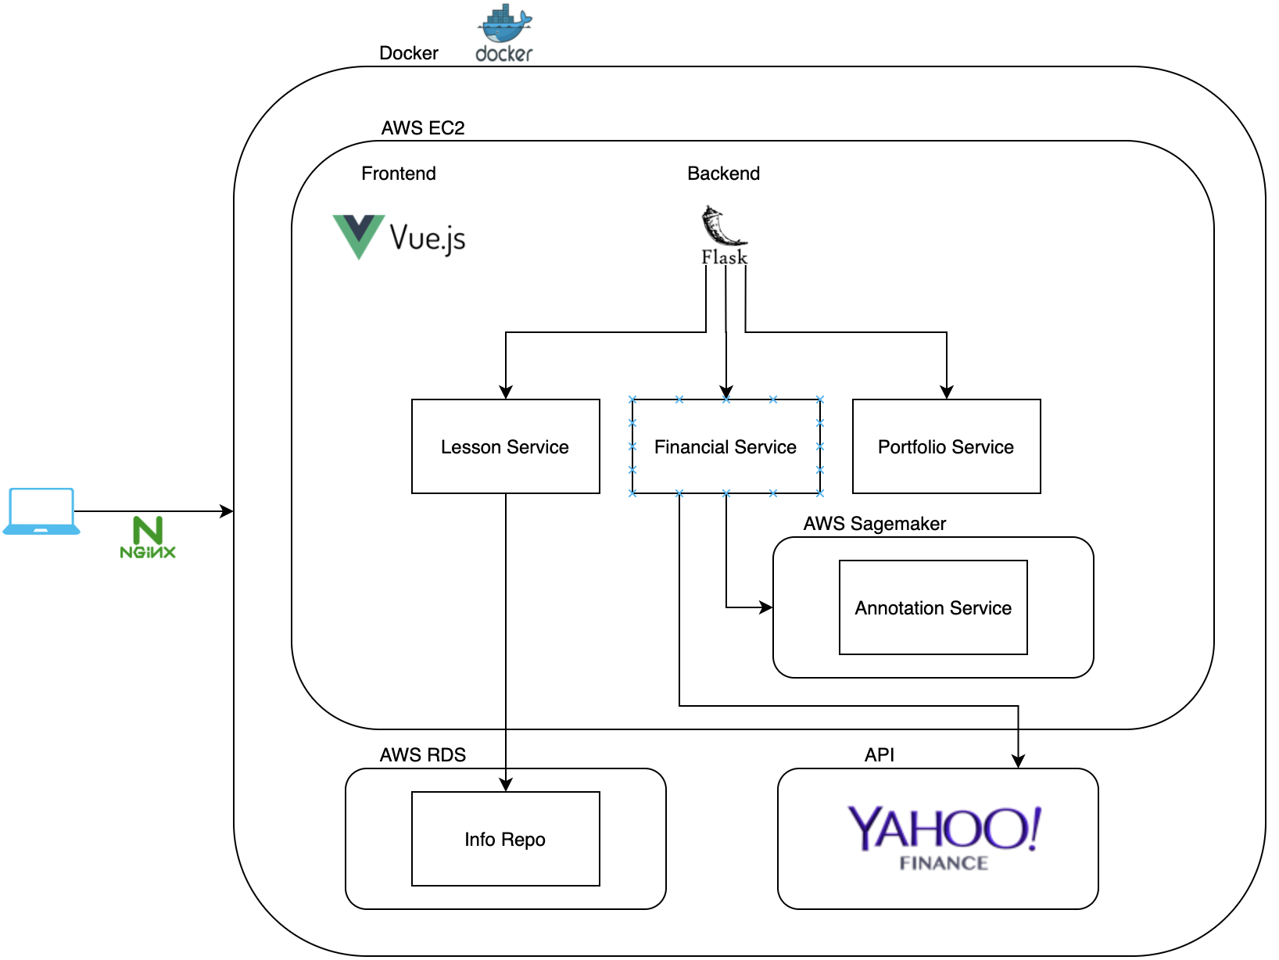
Architecture Diagram

Slide 8

DEMO

Slide 9
Future Implementation
Capture user information to propose sophisticated investment portfolio recommendations
Integrate with existing trading platforms
Connecting users to seasoned investors with proven track record for mentoring

Slide 10


THANKS!

